Slide 1


Regional Database for the Mediterranean and Black Seas
“Developing a fisheries information system for the Med&BS”
Progress Work
2024 Liaison Meeting, September 24-25

Slide 2


MARE/2020/08 - SI2.839444
Development of the Regional Database for the Mediterranean & Black Seas (Med&BS RDBFIS)
This project has financed under the European Maritime and Fisheries Fund (EMFF)
(period: 01/01/2021 – 28/02/2023)
CINEA/EMFAF/2021/3.1.2/03/SC04/SI2.881222
Specific Contract 2021/3.1.2/03/SC04
Hosting, maintenance and further development of the Regional Database for the Mediterranean and Black Seas
(period: 01/04/2023 – 31/03/2025)

Slide 3
RDBFIS progress work -> populate the system with data
Aggregated data
Med&BS
FDI (Tables A, B, G, H, I, J)
AER
GFCM/DCRF
MEDITS
TA, TB, TC
Detailed biological & landings data
Notes:
A data call was drafted to the relevant Member States of the Med&BS region. The requested datasets covers the periods of the DCR & DCF programs
2002-2022 for Med&BS datacall,
2013-2022 for FDI datacall,
2017-2022 for GFCM/DCRF datacall,
Med&BS RCG data (DCR & DCF: fishing intensity, landings).
Detailed biological data
MEDITS data
AER data
The JRC and GFCM provided the requested datasets;
The Member States are invited to use the RDBFIS to execute syntax and data quality control procedures and store the clean data into the system (through a strict set of validation rules solid based on the datacall ANNEXES). A dedicated RDBFIS team support this process through bilateral contacts and working jointly with the Member States. The process is progressing satisfactorily, the RDBFIS core team supports all MSs’ requirements.

Slide 4

RDBFIS progress work -> MEDIAS integration
1. MEDIAS database structure
Acoustics, Pelagic trawl, CTDs
2. Integration with RDBFIS
3. Validation scheme (acoustics, pelagic trawl)
4. Consistency check (R)
5. Processing (SQL)
Abundance, Biomass, Abundance-Biomass
6. Eggs & Larvae database structure
__________________________________
The MEDIAS data call is in progress, with a workshop scheduled for the end of October

Slide 5

RDBFIS progress work -> MEDITS survey
Updated versions
RoME
RoMEBS
BioIndex integration
Notes:
A data call was drafted to the relevant Member States of the Med&BS region. The requested datasets covers the periods of the DCR & DCF programs
2002-2022 for Med&BS datacall,
2013-2022 for FDI datacall,
2017-2022 for GFCM/DCRF datacall,
Med&BS RCG data (DCR & DCF: fishing intensity, landings).
Detailed biological data
MEDITS data
AER data
The JRC and GFCM provided the requested datasets;
The Member States are invited to use the RDBFIS to execute syntax and data quality control procedures and store the clean data into the system (through a strict set of validation rules solid based on the datacall ANNEXES). A dedicated RDBFIS team support this process through bilateral contacts and working jointly with the Member States. The process is progressing satisfactorily, the RDBFIS core team supports all MSs’ requirements.

Slide 6
RDBFIS progress work -> RDBqc & RDBprocessing updates
In the framework of Qualitrain and RDBFIS, improvements were made on the R packages supporting the data quality and processing.
Within RDBFIS, the packages have been updated, replacing the older versions.
Notes:
A data call was drafted to the relevant Member States of the Med&BS region. The requested datasets covers the periods of the DCR & DCF programs
2002-2022 for Med&BS datacall,
2013-2022 for FDI datacall,
2017-2022 for GFCM/DCRF datacall,
Med&BS RCG data (DCR & DCF: fishing intensity, landings).
Detailed biological data
MEDITS data
AER data
The JRC and GFCM provided the requested datasets;
The Member States are invited to use the RDBFIS to execute syntax and data quality control procedures and store the clean data into the system (through a strict set of validation rules solid based on the datacall ANNEXES). A dedicated RDBFIS team support this process through bilateral contacts and working jointly with the Member States. The process is progressing satisfactorily, the RDBFIS core team supports all MSs’ requirements.

Slide 7
RDBFIS progress work -> AER integration
Perform syntax and consistency checks before submitting data to the JRC. The aim is to decrease discrepancies between the AER and FDI datacalls (cross checking between AER & FDI is a goal for the project)
Specific economic performance indicators for STECF EWG purposes is under construction (NISEA)
Clean data ready for submission
Member States
Syntax & Consistency
JRC
Upload
Notes:
A data call was drafted to the relevant Member States of the Med&BS region. The requested datasets covers the periods of the DCR & DCF programs
2002-2022 for Med&BS datacall,
2013-2022 for FDI datacall,
2017-2022 for GFCM/DCRF datacall,
Med&BS RCG data (DCR & DCF: fishing intensity, landings).
Detailed biological data
MEDITS data
AER data
The JRC and GFCM provided the requested datasets;
The Member States are invited to use the RDBFIS to execute syntax and data quality control procedures and store the clean data into the system (through a strict set of validation rules solid based on the datacall ANNEXES). A dedicated RDBFIS team support this process through bilateral contacts and working jointly with the Member States. The process is progressing satisfactorily, the RDBFIS core team supports all MSs’ requirements.

Slide 8
This innovative R package is designed to estimate the spatial effort, weight, and value of landings in small-scale fisheries (SSF) for data-limited scenarios, specifically for vessels under 12 meters in length. The tool utilizes a Multi-Criteria Decision Analysis (MCDA) approach and includes scripts and demos that can be run locally to facilitate key procedures. These procedures include preparing environmental and anthropogenic data, as well as data from the EU fleet register (or more detailed sources if available), which are used to estimate a proxy for fishing effort. Additionally, part of this tool will be integrated into RDBFIS, facilitating the estimation of fishing effort and landings in the format of Tables H and I. The package enables users to apply the MCDA-derived proxy for fishing effort, combine it with Tables A and G (as submitted in the data call), integrate results from species distribution models, and estimate spatial effort, landings, and value by fishing rectangle or at finer resolutions. The tool also generates maps to visualize these estimations.
RDBFIS progress work -> Estimating the spatial FE & landings for SSF (FDI Tables H, I)

Slide 9
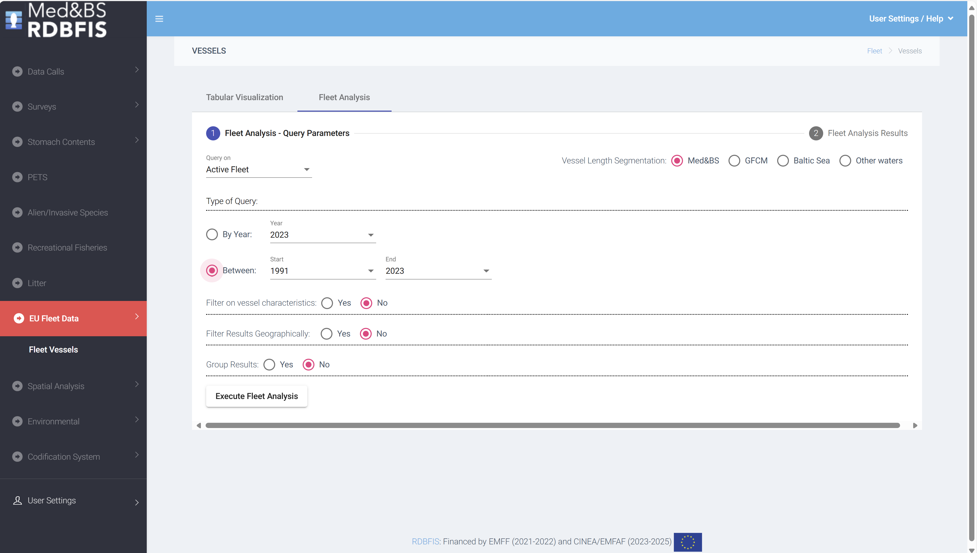
RDBFIS progress work -> EU fleet analysis
Fleet analysis: an open access dynamic tool has developed to illustrate the evolution of the fleet dynamics in Europe; potential links with the landings, discards and value (FDI Table A);
Data from the professional fishing fleet, spanning the period from 1991 to 2023, was downloaded from the official EU Fleet Register portal. GIS techniques were employed to spatially join the fishing ports with various geographical entities, including NUTS2 and NUTS3, FDI subregions, Geographical areas (GFCM, ICES). The fishing ports were match to LOCODE from the CIRCAMB Master Data Register. The accuracy of the fishing port locations was validated using information available from the IFREMER Sextant portal.
Reports can be generated based on user-defined queries about active or decommissioned fishing vessels
Notes:
fleet analysis tool: potential links with the landings/discards/values – FDI table A

Slide 10
RDBFIS progress work -> quality checks on FDI spatial data, Table H & I
-> Stomach contents data entry form
-> how RDBFIS can contribute to MSFD
Stomach contents
Med&BS and ICES structures were adopted
User friendly data entry form
RDBFIS → MSFD
Predefined queries to mine data from RDBFIS and deliver to MSFD experts
D1-Biodiversity
D2-Non-Indigenous Species
D3-Commercially-exploited fish and shellfish
D4-Food weds
D6-Seabed integrity
D10-Marine Litter
The activity has been completed in terms of gathering information from MSFD experts
quality checks on FDI spatial data (Table H & I):
integrated, optional to run in MS level
Maurizio, Maciej, Maksims
Maps & error reports are produced
Notes:
A data call was drafted to the relevant Member States of the Med&BS region. The requested datasets covers the periods of the DCR & DCF programs
2002-2022 for Med&BS datacall,
2013-2022 for FDI datacall,
2017-2022 for GFCM/DCRF datacall,
Med&BS RCG data (DCR & DCF: fishing intensity, landings).
Detailed biological data
MEDITS data
AER data
The JRC and GFCM provided the requested datasets;
The Member States are invited to use the RDBFIS to execute syntax and data quality control procedures and store the clean data into the system (through a strict set of validation rules solid based on the datacall ANNEXES). A dedicated RDBFIS team support this process through bilateral contacts and working jointly with the Member States. The process is progressing satisfactorily, the RDBFIS core team supports all MSs’ requirements.

Slide 11
RDBFIS: 2024 RCG Med&BS
In the 2024 Med&BS meeting, the RCG set the following priority for the servicing of data calls through RDBFIS:
1. High: Med & BS data call (obligatory from 2025);
2. Medium: FDI (optional for 2025);
3. Low: AER, GFCM (no timeline defined).
The RDBFIS coordinator will liaise with JRC to explore if / how RDBFIS can transmit data on behalf of the Member States and receive a notification.
Data access: the RCG document is adopted by the RDBFIS
Notes:
STAT: The scope of the workshop will be twofold: (i) to provide the background information on the existing statistical systems of the involved MSs (by means of a report) and (ii) to investigate the possibility of optimizing /adapting (if needed) the most commonly used methodology on the raising procedures so that it can serve as a recommended option to be followed by the MSs of the Med and Black Sea through the RDBFIS.
2002-2022 for Med&BS datacall,
2013-2022 for FDI datacall,
2017-2022 for GFCM/DCRF datacall,
Med&BS RCG data (DCR & DCF: fishing intensity, landings).
Detailed biological data
MEDITS data
AER data
The JRC and GFCM provided the requested datasets;
The Member States are invited to use the RDBFIS to execute syntax and data quality control procedures and store the clean data into the system (through a strict set of validation rules solid based on the datacall ANNEXES). A dedicated RDBFIS team support this process through bilateral contacts and working jointly with the Member States. The process is progressing satisfactorily, the RDBFIS core team supports all MSs’ requirements.

Slide 12
RDBFIS -> roadmap
MEDIAS workshop and datacall;
Integration of MCDA-SSF package;
AER consistency checks and processing routines;
Bilateral meeting for the detailed biological data;
Bilateral meeting for the statistical system and raising methods applied from the Med&BS MS, workshop;
Eggs&Larvae database, PETS, recreational fisheries and alien species;
RDBFIS 2nd training (in person, January 2025)
keep open the channel with ICES and RCG LP
Generation of predefined queries for MSFD purposes
Optimization of R code
Notes:
STAT: The scope of the workshop will be twofold: (i) to provide the background information on the existing statistical systems of the involved MSs (by means of a report) and (ii) to investigate the possibility of optimizing /adapting (if needed) the most commonly used methodology on the raising procedures so that it can serve as a recommended option to be followed by the MSs of the Med and Black Sea through the RDBFIS.
2002-2022 for Med&BS datacall,
2013-2022 for FDI datacall,
2017-2022 for GFCM/DCRF datacall,
Med&BS RCG data (DCR & DCF: fishing intensity, landings).
Detailed biological data
MEDITS data
AER data
The JRC and GFCM provided the requested datasets;
The Member States are invited to use the RDBFIS to execute syntax and data quality control procedures and store the clean data into the system (through a strict set of validation rules solid based on the datacall ANNEXES). A dedicated RDBFIS team support this process through bilateral contacts and working jointly with the Member States. The process is progressing satisfactorily, the RDBFIS core team supports all MSs’ requirements.

Slide 13

CINEA/EMFAF/2021/3.1.2/03/SC04/SI2.881222
Specific Contract 2021/3.1.2/03/SC04
Hosting, maintenance and further development of the Regional Database for the Mediterranean and Black Seas
We thank you for your attention
https://rdbfis.eu/
Maurizio GIBIN, Maciej ADAMOWICZ, Maksims KOVSARS quality (checks on spatial information and mapping for the FDI EWG)

